Slide 1
Distance Based Models
Tomas Karpati MD tc.datascience@gmail.com
054-2002430

Slide 2
k-Nearest Neighbour
kNN

Slide 3
k-Nearest Neighbours
?
?

Slide 4
k-Nearest Neighbours
Distance calculation methods:
Canberra (∑(|x_{i} - y_{i}|/|x_{i} + y_{i}|))
Minkowski ( (∑|(x_{i} - y_{i})|^{p})^{1/p} )
Euclidian (√∑(x_{i} - y_{i})²)
Maximum ( max(x_{i} - y_{i}) )
Manhattan ( ∑|(x_{i} - y_{i})| )
∑(x_{i}y_{i})
Cosine 1-
(√∑x_{i}²)(√∑y_{i}²)

Slide 5
k-Nearest Neighbours
k = 1
k = 2
?
k = 3
?
?

Slide 6
k-Nearest Neighbours
k = 5
kNN Parameters
k = # of neighbours
distance = Euclidean
?
?
?

Slide 7
k-Nearest Neighbours
kNN for Regression problems
Select an appropriate k
Calculate the distances
Get the mean distance for the k points
Calculate the new point on the multidimensional space
Assign the point to the y

Slide 8
k-Nearest Neighbours
Summary
Non-parametric (do not make assumptions on the data)
kNN Algorithm is based on feature similarity
Considered a lazy algorithm
It has no explicit training phase (uses all the dataset)
kNN can be used for classification (voting) or for regression (mean, median)

Slide 9
k-Nearest Neighbours
Pros
Useful when having small datasets
No assumptions on data distributions
Relative high accuracy
Cons
Computationally expensive
Sensitive to outliers
Sensitive to the scale of the data

Slide 10
Support Vector Machine
SVM

Slide 11
Support Vector Machine

Slide 12
Support Vector Machine
Hyperplane
Support Vectors
Margin

Slide 13
Support Vector Machine

Slide 14
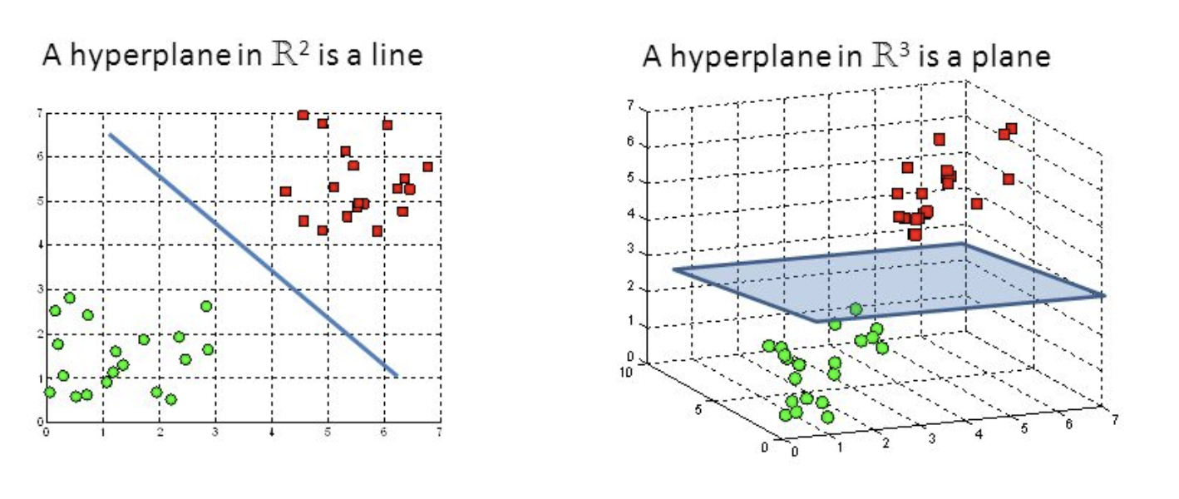
Support Vector Machine

Slide 15
Support Vector Machine
Low dimensional space
Kernel
trick
Higher dimensional space

Slide 16
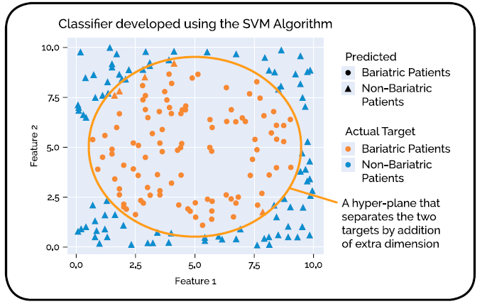
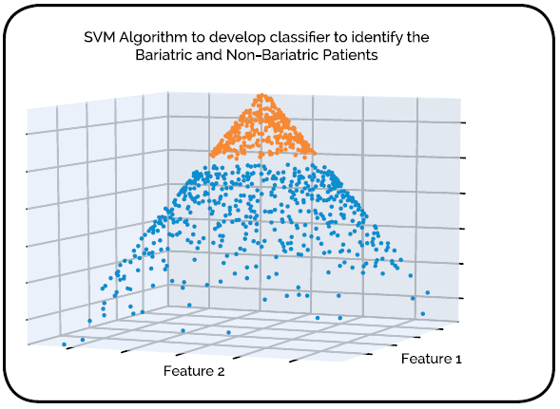
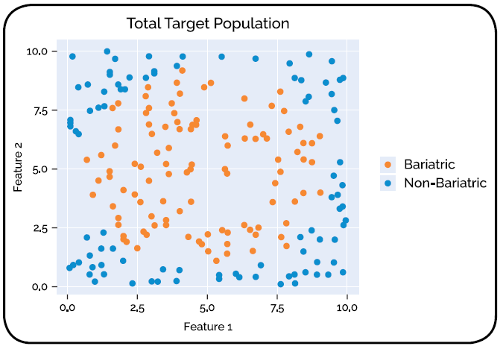
Support Vector Machine
https://www.youtube.com/watch?v=3liCbRZPrZA

Slide 17
Support Vector Machine
SVM Hyperparameters:
Kernel (or kernel trick):
Linear
Radial basis function (rbf)
Polynomial
Sigmoid
gamma
c (cost)

Slide 18
Support Vector Machine
Gamma: The gamma parameters can be seen as the inverse of the radius of influence of samples selected by the model
C (Cost): Penalty parameter of the error term. It also controls the trade off between smooth decision boundary and classifying the training points correctly.

Slide 19
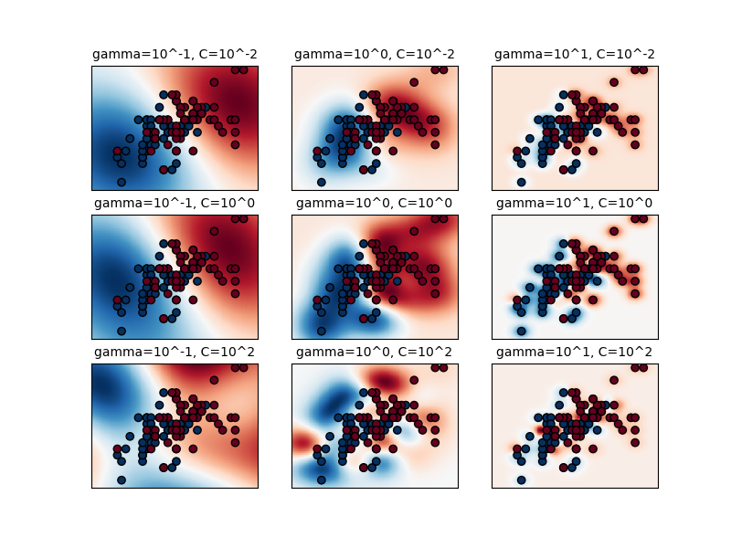
Support Vector Machine

Slide 20
Support Vector Machine
Pros
Very accurate models
Work well with high dimensionality
Uses only a small sample of the dataset (support vectors)
Memory efficient
Cons
Large computation time with very large datasets
Bad performance when lot of noise (overlapping of classes)
From Zero to Hero: In-Depth Support Vector Machine

